Slide 1
Recommender Systems - CSE4077
J-Component Review
Article Recommendation System
Team Members
ROSHAN SRINIVAAS S (19MIA1001)
NIRANJAN J (19MIA1003)
VIGNESH N (19MIA1093)

Slide 2
In the last decade we have observed a mass increase of information, in particular information that is shared through smartphones. Consequently, the amount of information that is available does not allow the average user to be aware of all his options. In this context, recommender systems use a number of techniques to help a user find the desired product.
Problem Statement

Slide 3
Content based recommendation using News category dataset, the goal is to recommend news articles which are similar to the already read article by using attributes like article headline, category, author and publishing date. The number of news releases has grown rapidly and for one individual, it is cumbersome to browse through all online news resources for relevant news articles
Objective

Slide 4
News Recommendation with Recurrent Neural Networks, Gabriel de souza p. moreira, Dietmar jannach, adilson marques da cunha,2019 . Technique used is RNN, LSTM. Proposed hybrid approach leads to higher prediction accuracy.
News Recommendation Systems, Chong feng, Muzammil Khan, Journal of recommendation system,2020, Technique used is Collaborative Filtering Approach. News recommender systems (NRS) are developed to relieve the information overload problem and suggest news items that might be of interest for the news readers.
News Recommendation system ,Jing Qin Journal of recommendation model, 2020, Technique used is CF method, user-based collaborative filtering (UserCF) method, ItemCF, CNN. CF methods are used to calculate the similarity of users or news or MF-based modelling CF method have better accuracy than CB.
Recommender system for news articles using supervised learning, Akshay kumar chaturvedi Technique used is Linear regression, Naïve bayes classifier, Logistic regression. Linear regression turned out to be the best one. Number of classes and performance of model are inversely proportional to each other.
Literature Survey

Slide 5
The dataset contains around 200k news headlines from the year 2012 to 2018. The model trained on this dataset could be used to identify tags for untracked news articles or to identify the type of language used in different news articles.
Dataset

Slide 6
Algorithm used here is Content based filtering. The aim of a this content based recommender system is to estimate the utility of a set of objects belonging to a given domain, starting from the information available about users and objects. The basis for content-based recommendations is the similarity between users/items determined by their qualities. It makes use of extra data (meta data) about persons or objects, i.e., it depends on the kind of content that is already available. This meta data may include demographic information about the user, such as age, gender, occupation, location, and skill sets. Similar information may be found for products, including item name, details, category, registration date, etc. Therefore, the fundamental notion is to suggest items by identifying persons or items that are similar to the subject user or item based on those individual’s traits.
Algorithm

Slide 7
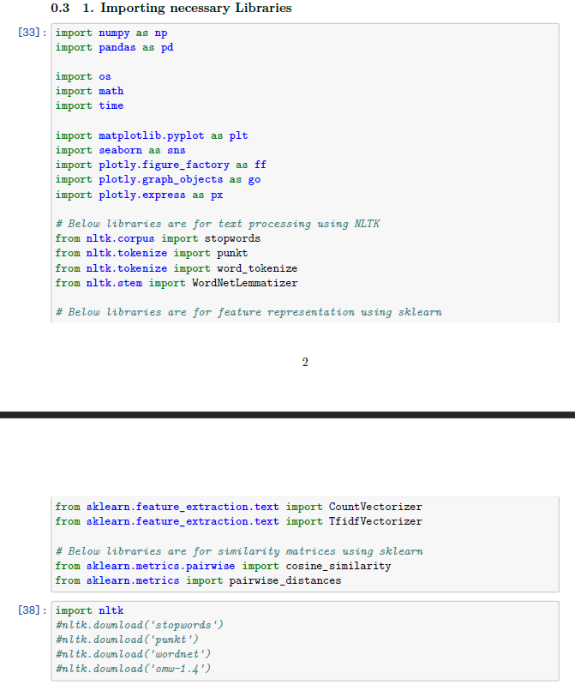
Importing Necessary Libraries

Slide 8
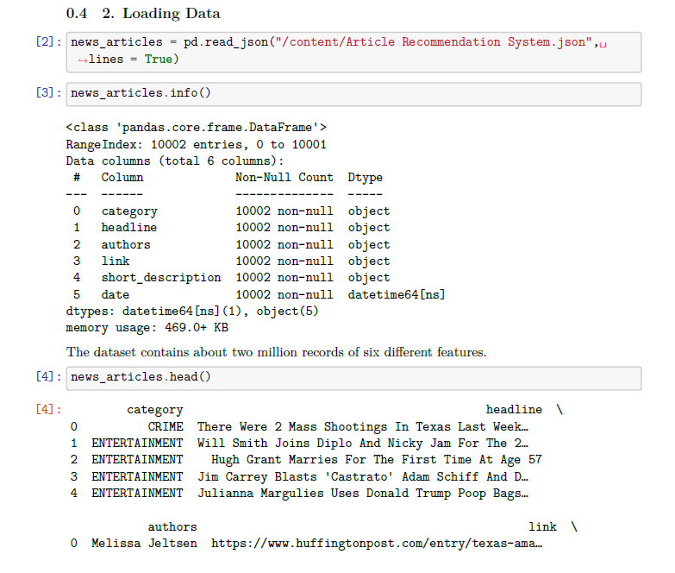
Loading Data

Slide 9
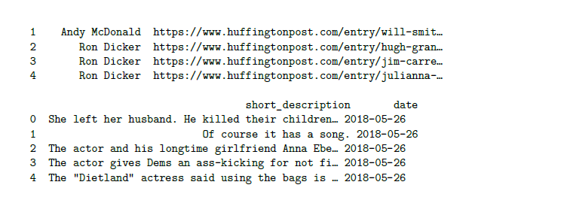
Loading Data

Slide 10
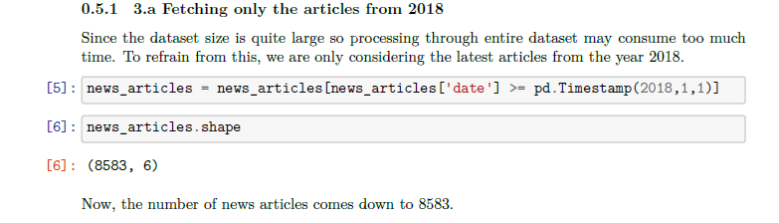
Data Pre-processing Fetching only the articles from 2018

Slide 11
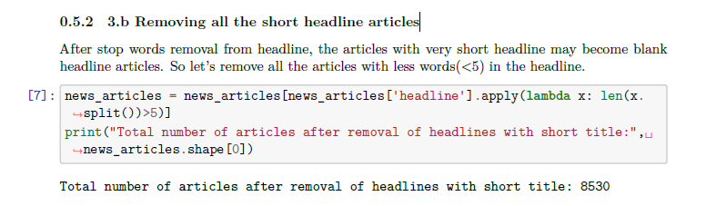
Removing all the short headline articles

Slide 12
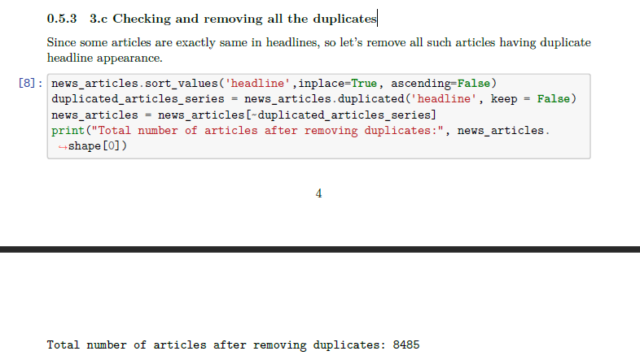
Checking and removing all the duplicates

Slide 13
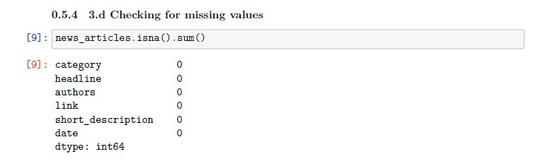
Checking for missing values

Slide 14
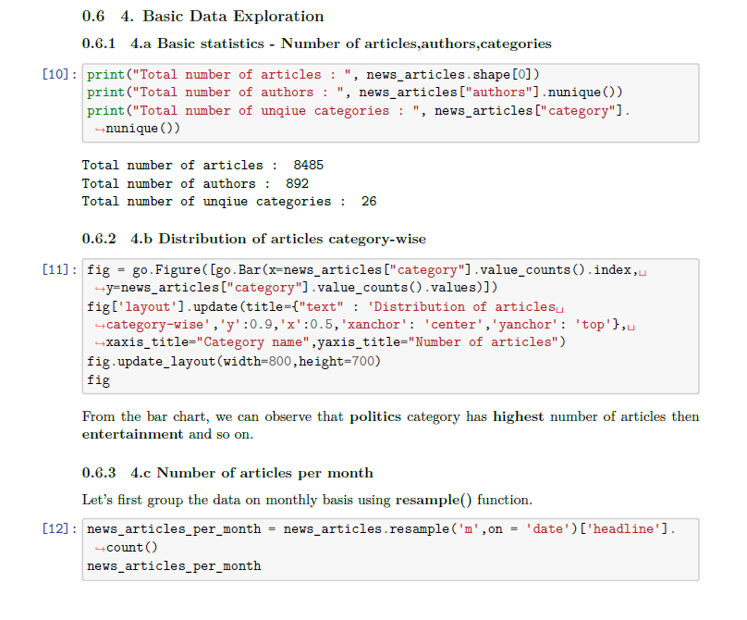
Basic Data Exploration

Slide 15
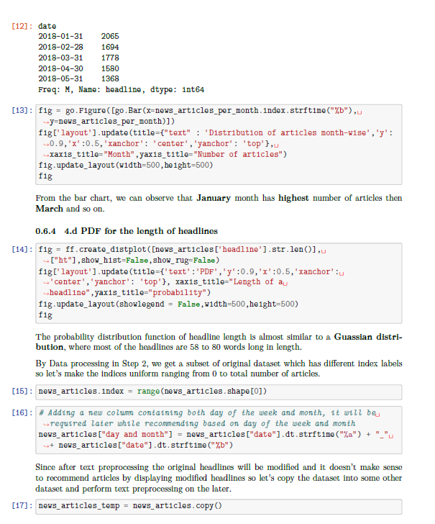

Slide 16
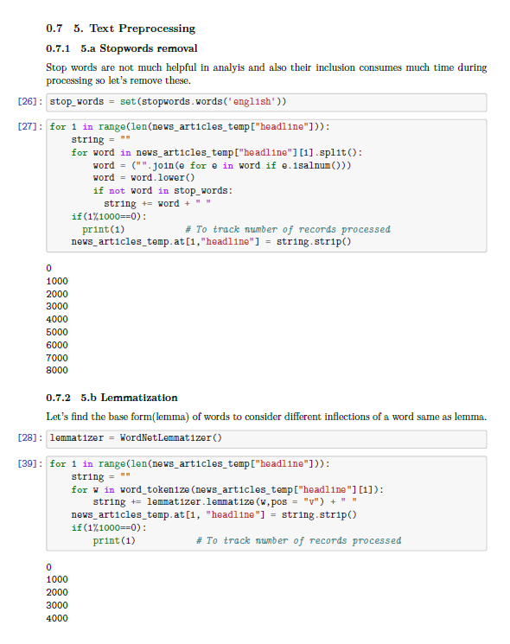
Text Pre-processing

Slide 17
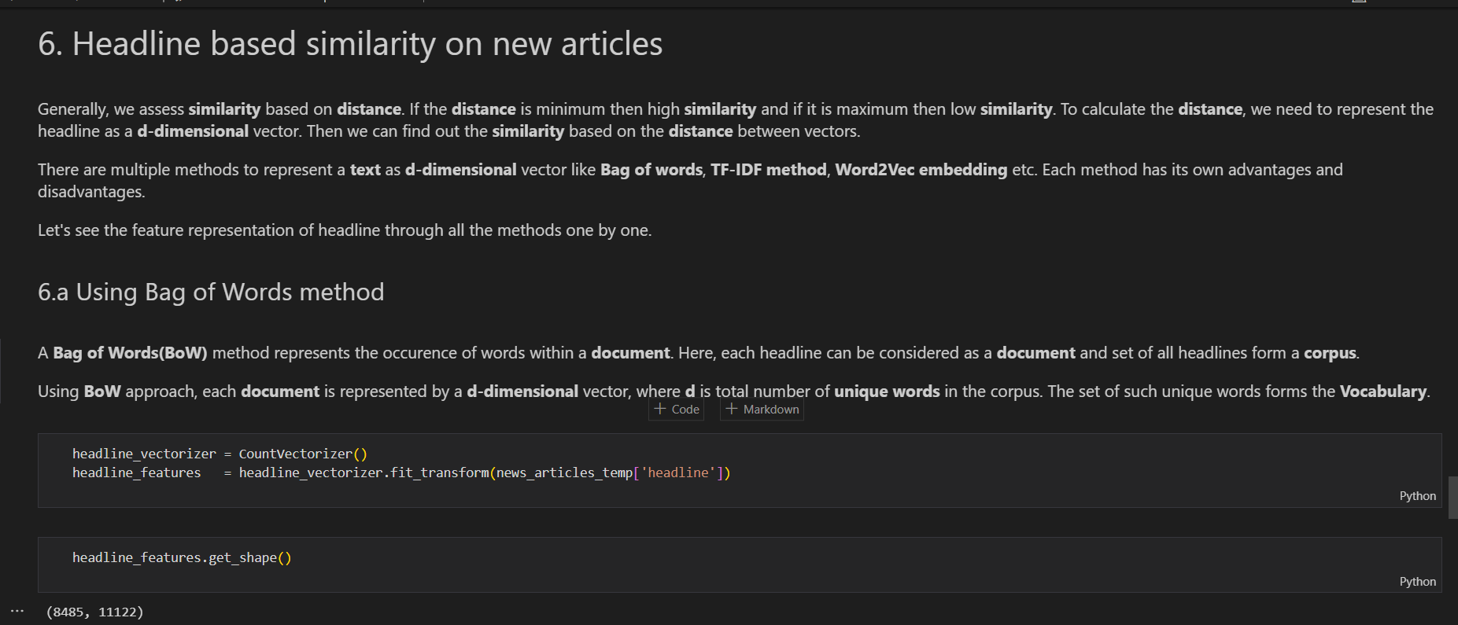
Recommendation using BoW

Slide 18
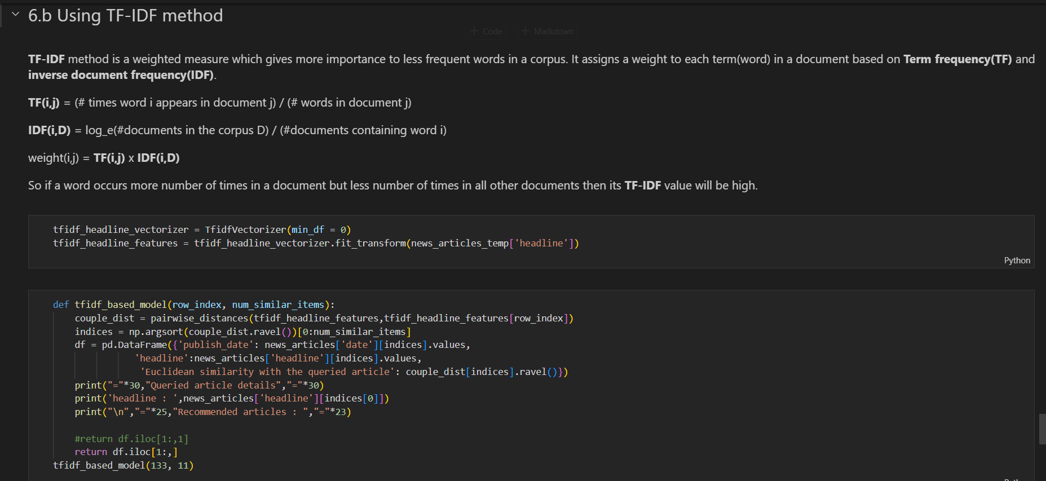
Recommendation using TF-IDF

Slide 19
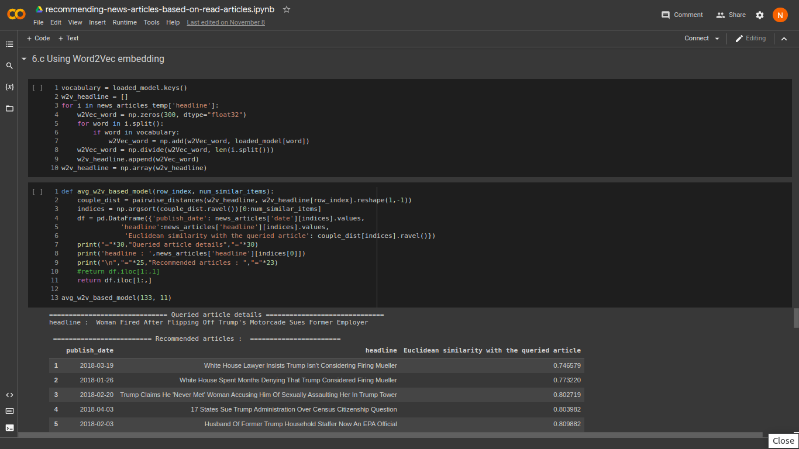
Recommendation using Word2Vec

Slide 20
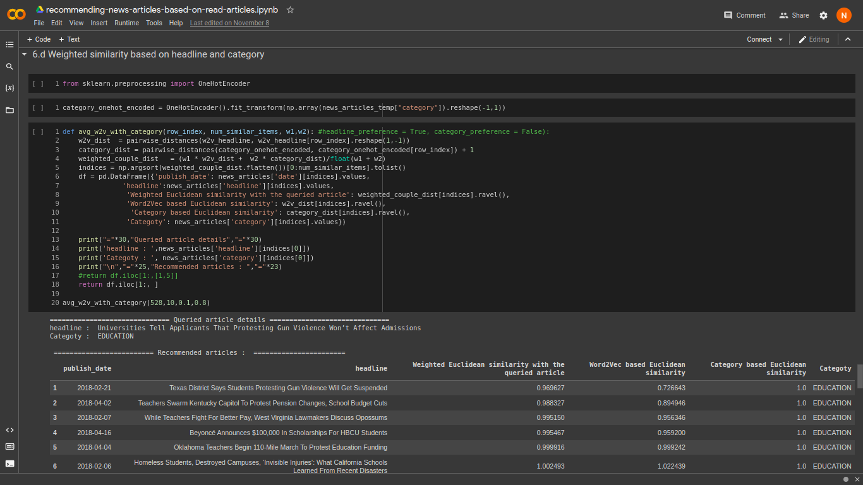
Recommendation using weighted similarity

Slide 21
Headline based similarity on news article were done using Bag of Words (BoW) method, TF-IDF method, Word2Vec method and Weighted similarity methods.
Conclusion

Slide 22
Link : https://github.com/Niranjan1112/Recommender-Systems
Code uploaded in github

Slide 23
Thank you!!!

